Slide 1
Unit 202: Principles of electrical science
Electronic components

Slide 2
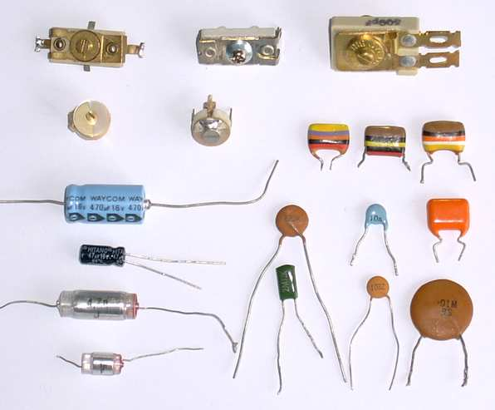

Electronic components
Capacitors

Slide 3
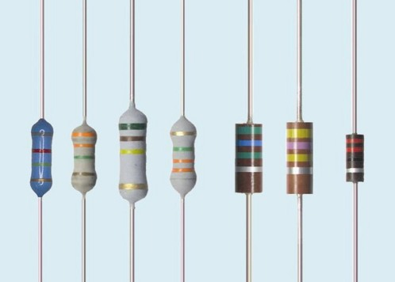
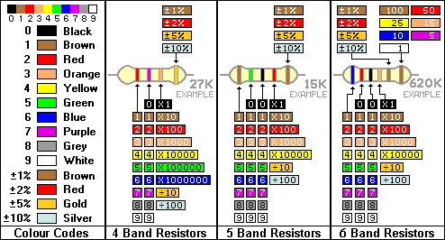
Electronic components
Resistors

Slide 4
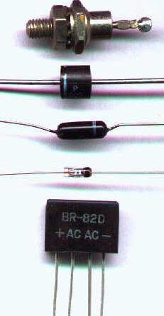
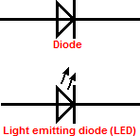
Electronic components
Diodes

Slide 5

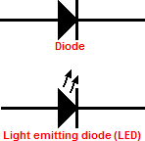

Electronic components
Diodes

Slide 6
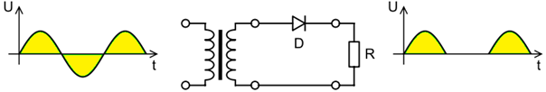
Electronic components
Rectification
In half wave rectification of a single-phase supply, either the positive or negative half of the a.c. wave is passed, while the other half is blocked. Because only one half of the input waveform reaches the output, mean voltage is lower. Half-wave rectification requires a single diode in a single-phase supply, or three in a three-phase supply.

Slide 7

Electronic components
Rectification
A full-wave rectifier converts the whole of the input waveform to one of constant polarity (positive or negative) at its output. Full-wave rectification converts both polarities of the input waveform to pulsating d.c. and yields a higher average output voltage. Four diodes in a bridge configuration and any a.c. source are needed.

Slide 8
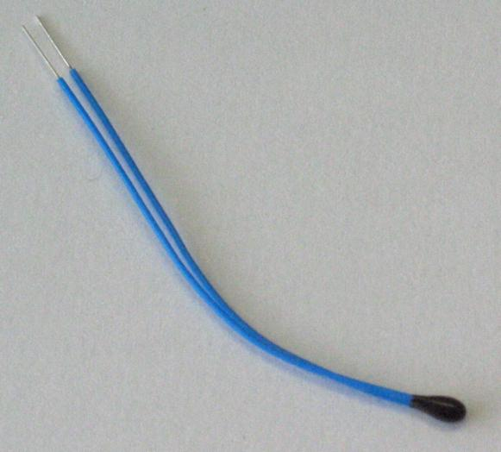

Electronic components
Thermistors

Slide 9

Electronic components
Diac

Slide 10
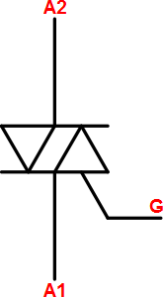
Electronic components
Triac

Slide 11
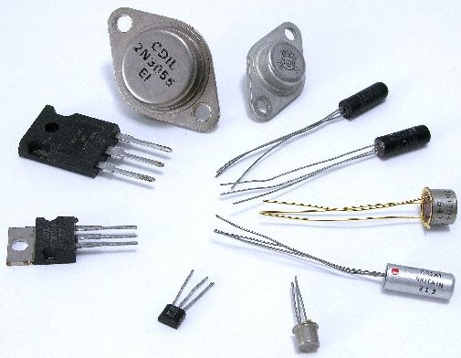
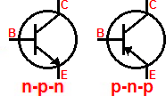
Electronic components
Transistors

Slide 12
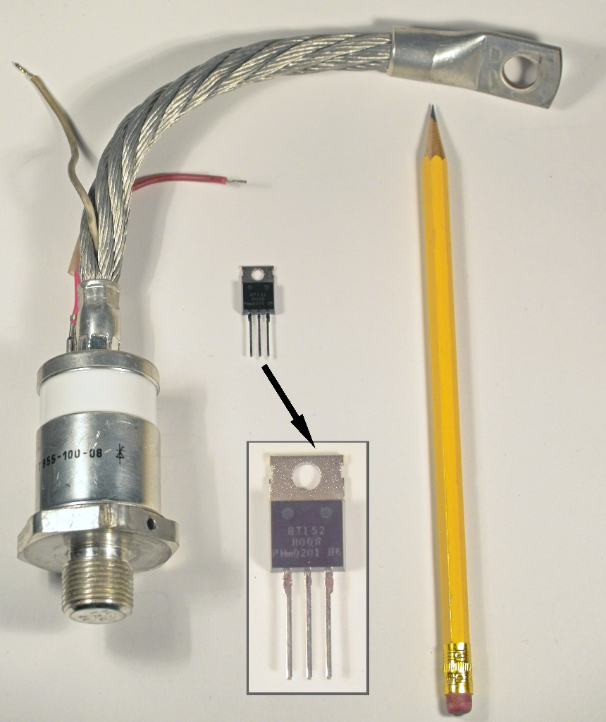
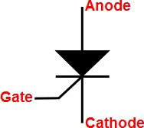
Electronic components
Thyristor

Slide 13
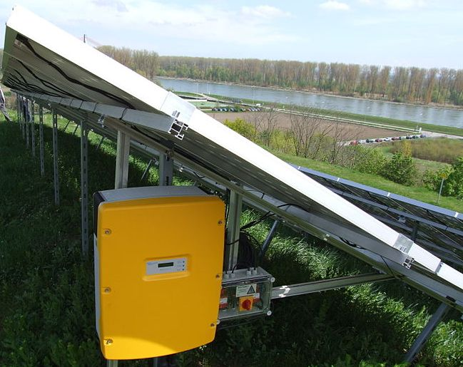
Electronic components
Invertor

Slide 14
Unit 202: Principles of electrical science
The End

